Slide 1

Crash Course
Hands-on Intro to Data Science
with Apache Spark
Robert Hryniewicz
Data Evangelist
@RobHryniewicz

Slide 2
Plan for Today
Data Science & ML
ML Examples
Overview of ML methods
K-means, Decision Trees & Random Forests
Spark MLlib & ML
Lab Overview

Slide 3
Data Science Examples

Slide 4
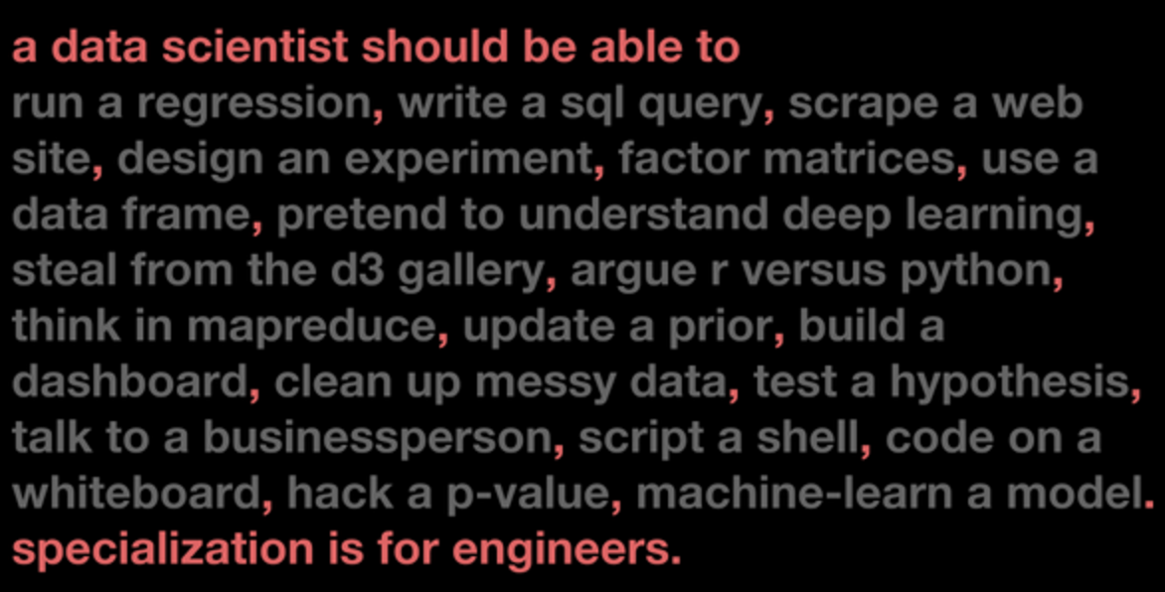

Slide 5
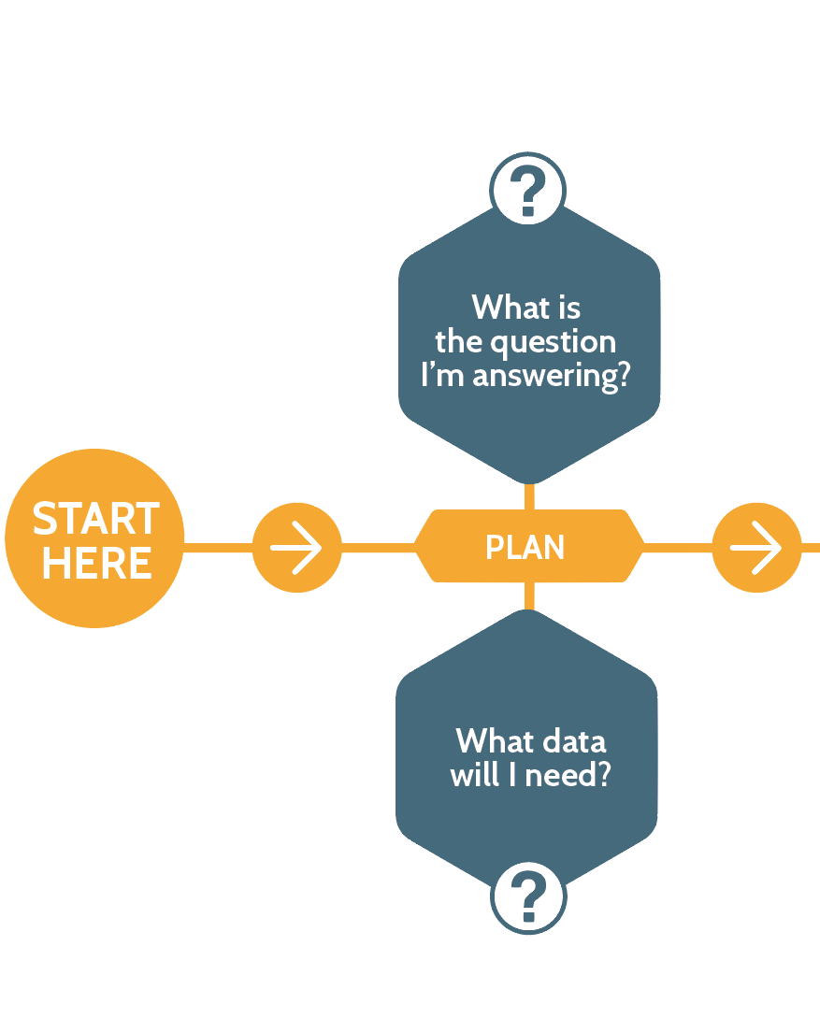
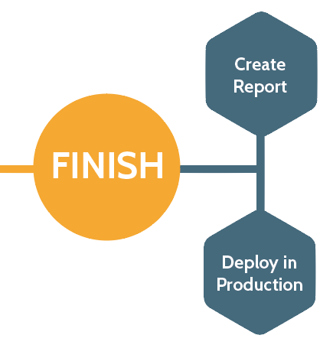


Predictive Analytics Pre-requisites
Sales Play 4: Predictive Analytics

Slide 6
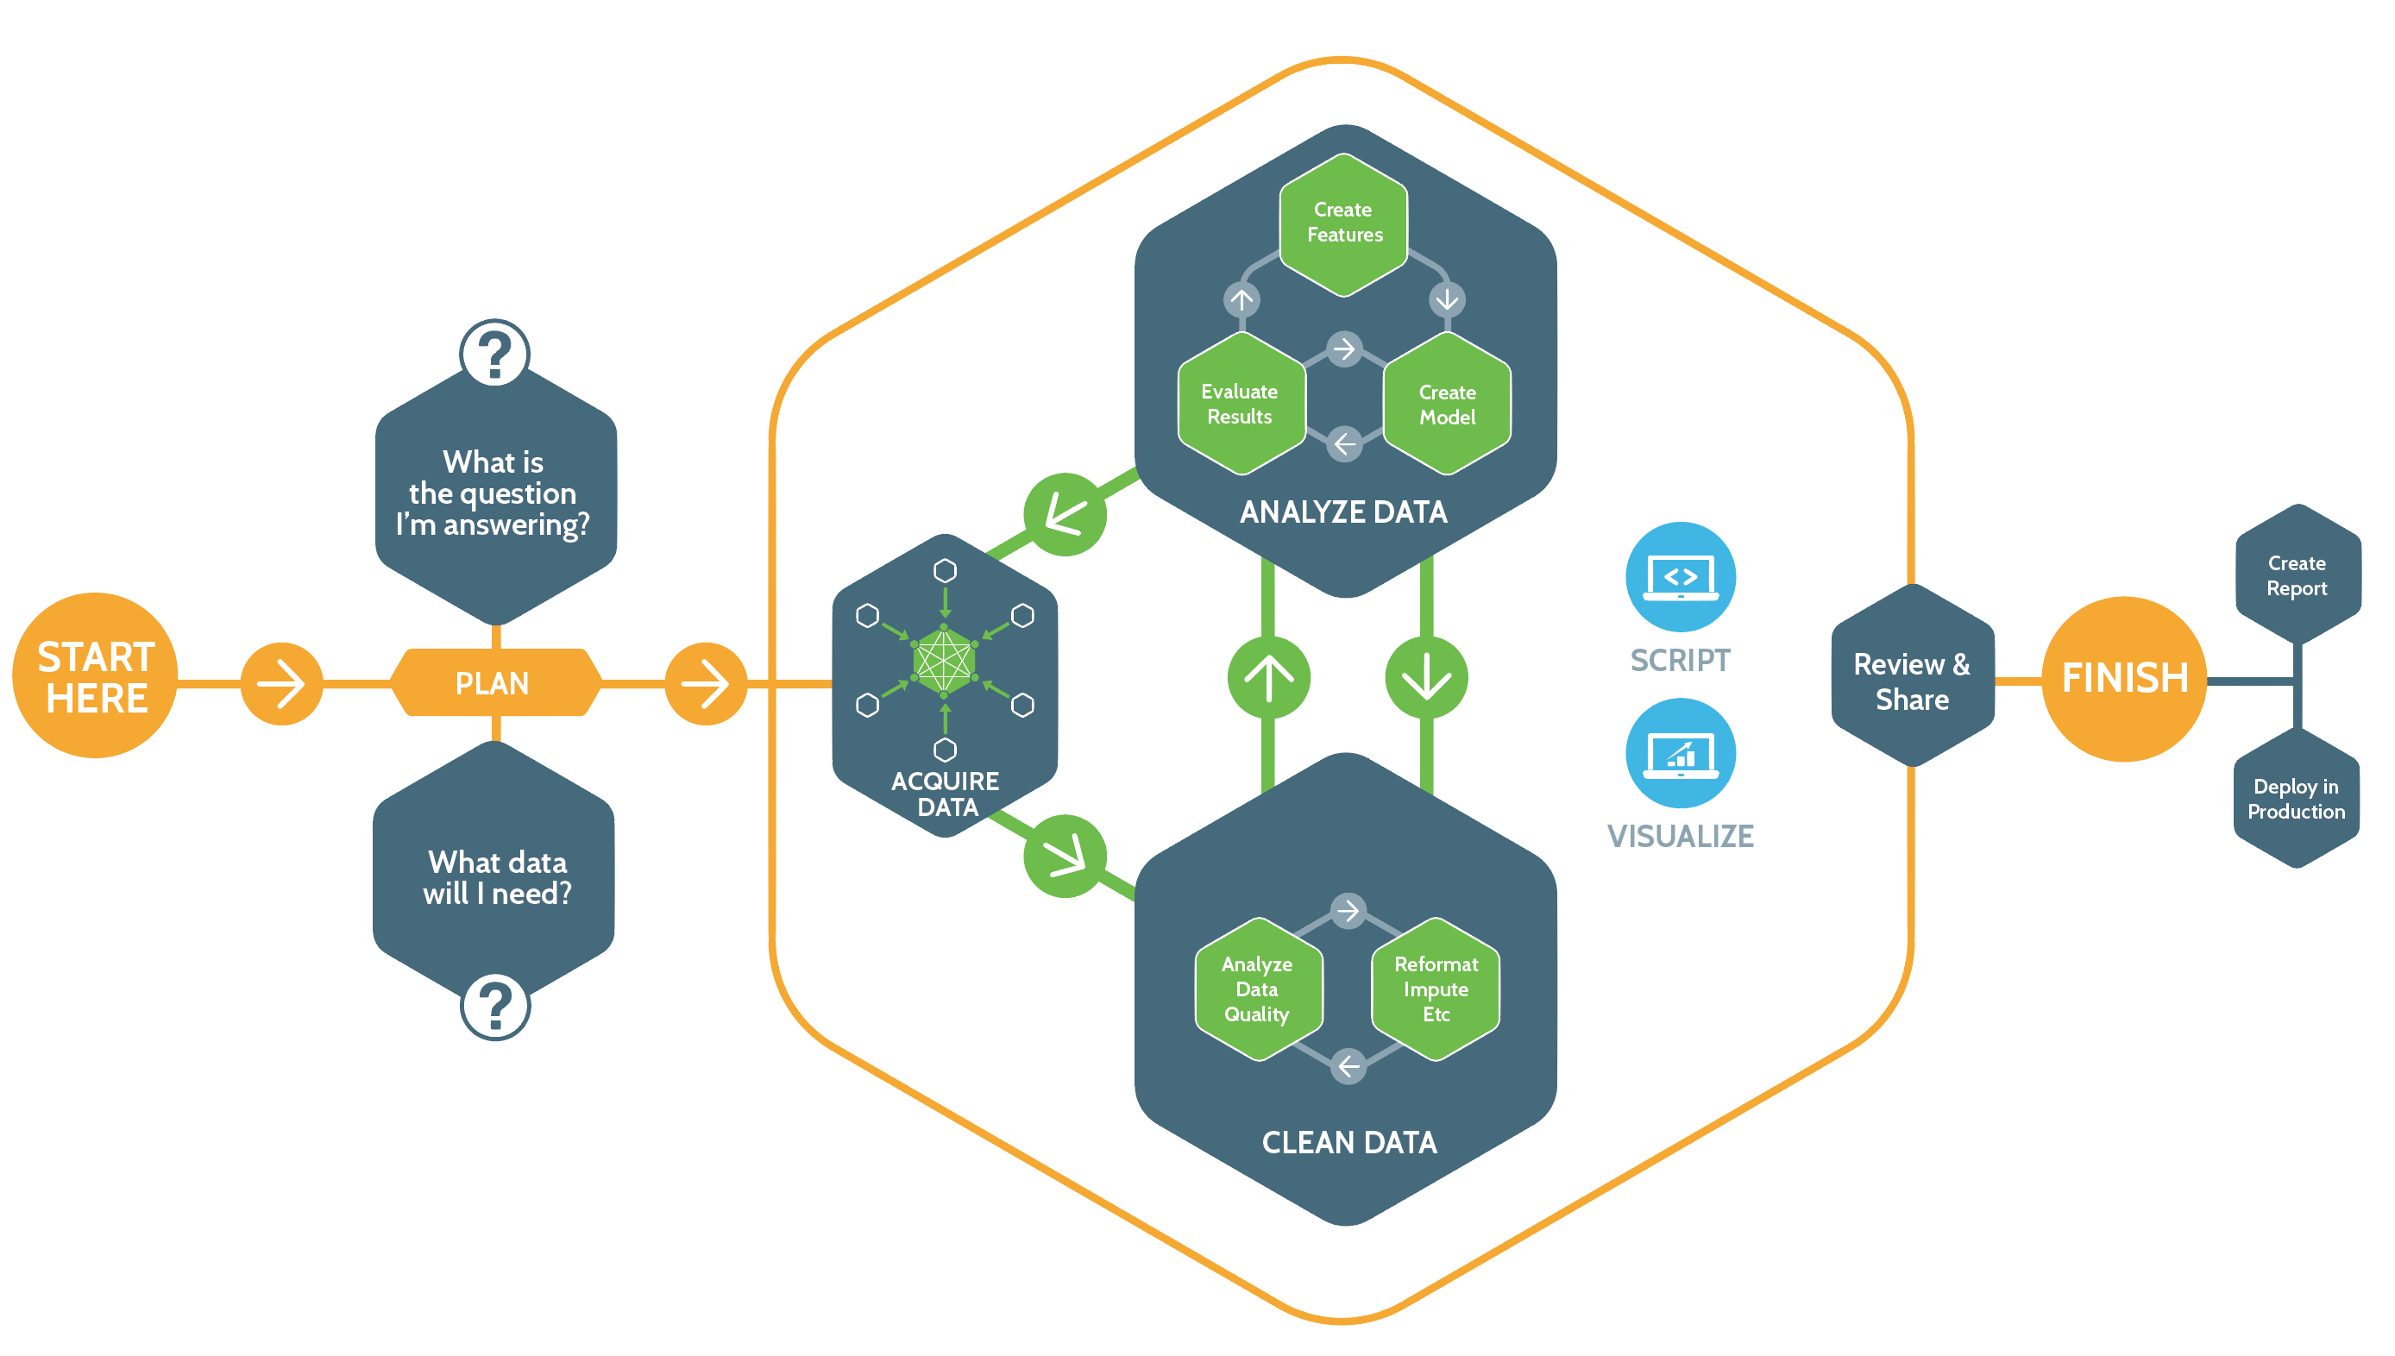









Predictive Analytics Process and Tools

Slide 7
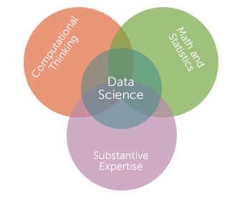
Machine Learning
“… science of how computers learn without being explicitly programmed” – Andrew Ng

Slide 8
Machine Learning Methods

Slide 9
Examples labeled.
Supervised
vs
Unsupervised
Learning
Examples not labeled.

Slide 10
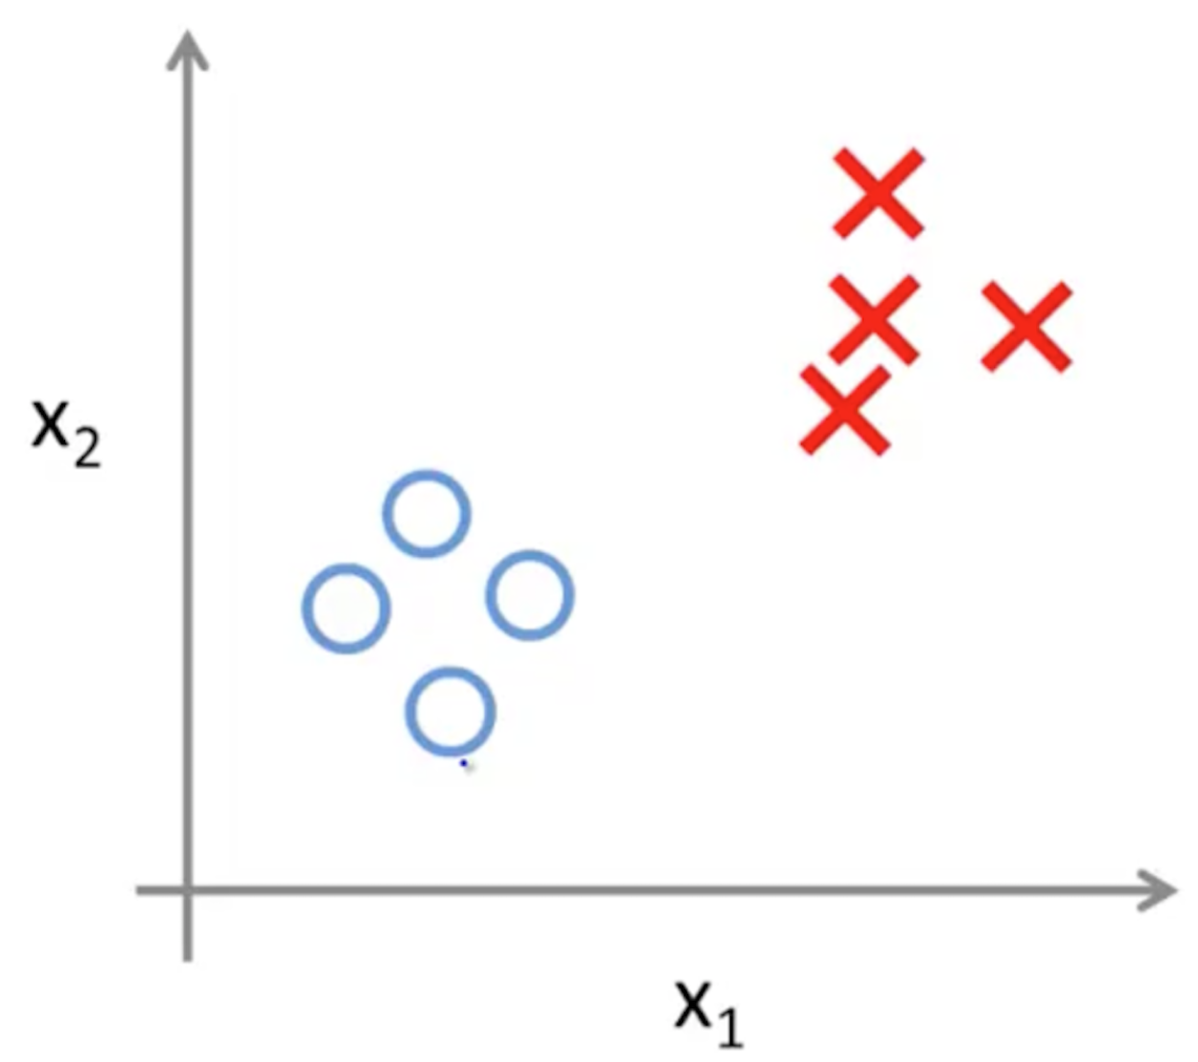
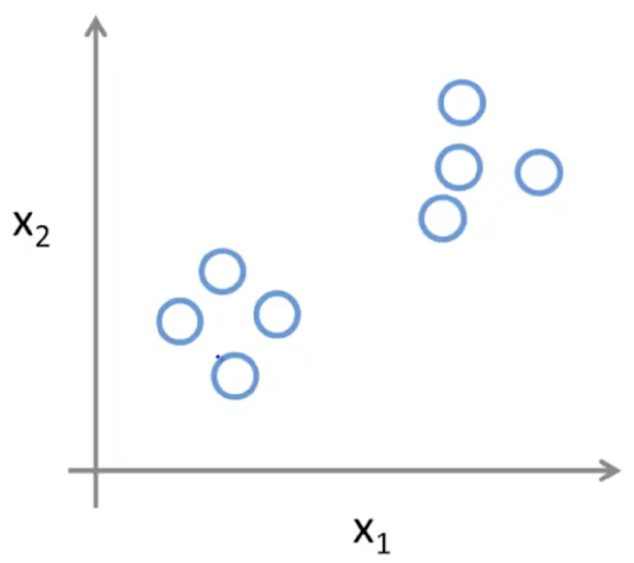
Supervised Learning
Unsupervised Learning

Slide 11
CLASSIFICATION
Identifying to which category an object belongs to.
Applications: spam detection, image recognition, ...
Algorithms: k-nn, decision trees, random forest, ...

Slide 12
REGRESSION
Predicting a continuous-valued attribute
associated with an object.
Applications: drug response, stock prices, …
Algorithms: linear regression, …

Slide 13
CLUSTERING
Automatic grouping of similar objects into sets. Applications: customer segmentation, topic modeling, …
Algorithms: k-means, LDA, …

Slide 14
COLLABORATIVE FILTERING
Fill in the missing entries of a user-item association matrix. Applications: Product recommendation, …
Algorithms: Alternating Least Squares (ALS)

Slide 15
DIMENSIONALITY REDUCTION
Reducing the number of random variables to consider.
Applications: visualization, increased efficiency, … Algorithms: PCA, t-SNE, …

Slide 16
PREPROCESSING
Feature extraction and normalization Applications: transforming input data such as text as input to ML algorithms
Algorithms: TF-IDF, word2vec, one hot encoding, …

Slide 17
MODEL SELECTION
Comparing, validating and choosing parameters and models. Applications: improved accuracy via parameter tuning
Algorithms: grid search, metrics …

Slide 18
Spark MLlib

Slide 19
Spark Machine Learning Library
Basic statistics
summary statistics
hypothesis testing
random number generation
Classification and regression
linear models (SVMs, log & linear regression)
decision trees
ensembles of trees (Random Forests & GBTs)
Collaborative filtering
alternating least squares (ALS)
Clustering
k-means clustering
latent Dirichlet allocation (LDA)
Dimensionality reduction
singularity value decomposition (SVD)
principal component analysis (PCA)
Feature Extractors & Transformers
word2vec

Slide 20
K-Means Clustering (Unsupervised Learning)

Slide 21
Why K-Means
Simple & fast algorithm to find clusters
Common technique for anomaly detection
Drawbacks
Doesn't work well with non-circular cluster shape
Number of cluster and initial seed value need to be specified beforehand
Strong sensitivity to outliers and noise
Low capability to pass the local optimum.

Slide 22
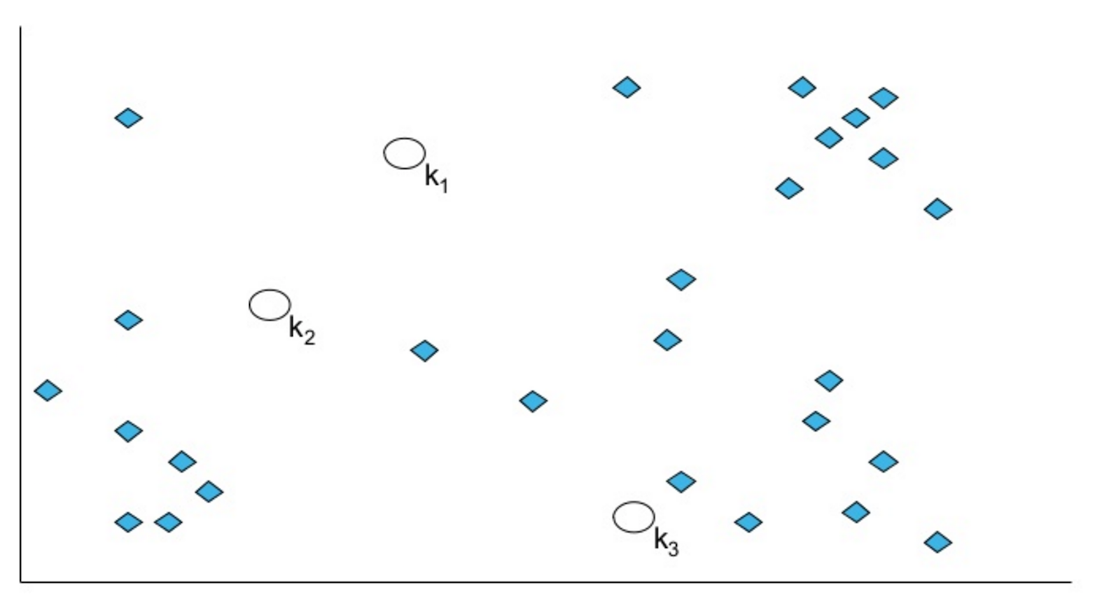
Initialize Cluster Centers
Randomly pick 3 cluster centers.

Slide 23
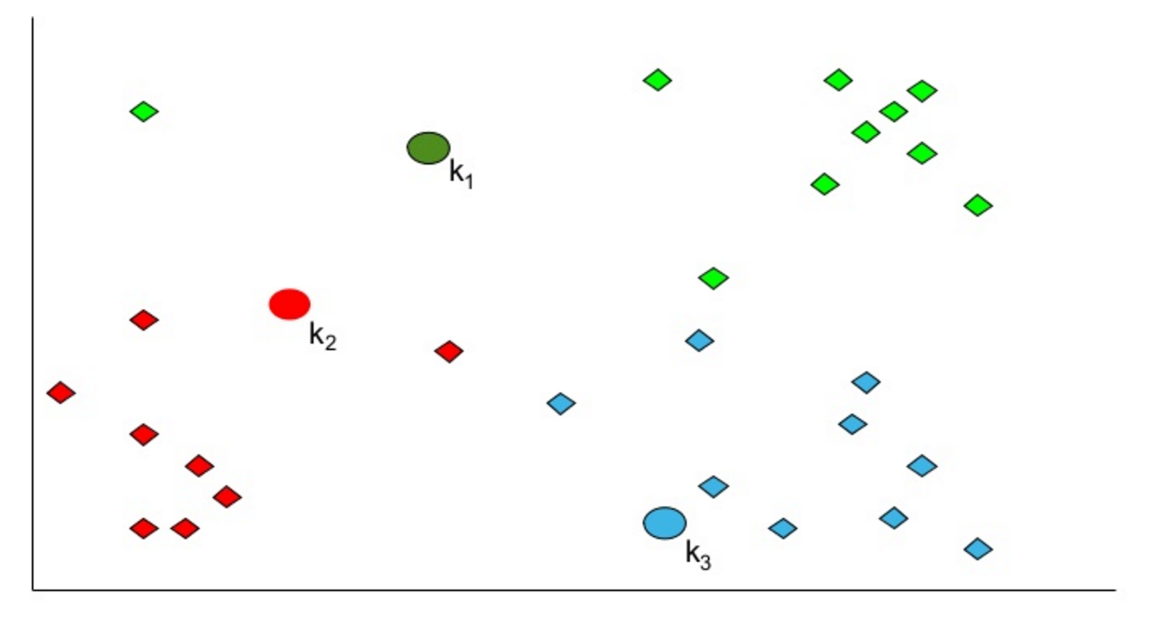
Assign Each Point
Assign each point to the nearest cluster center.

Slide 24
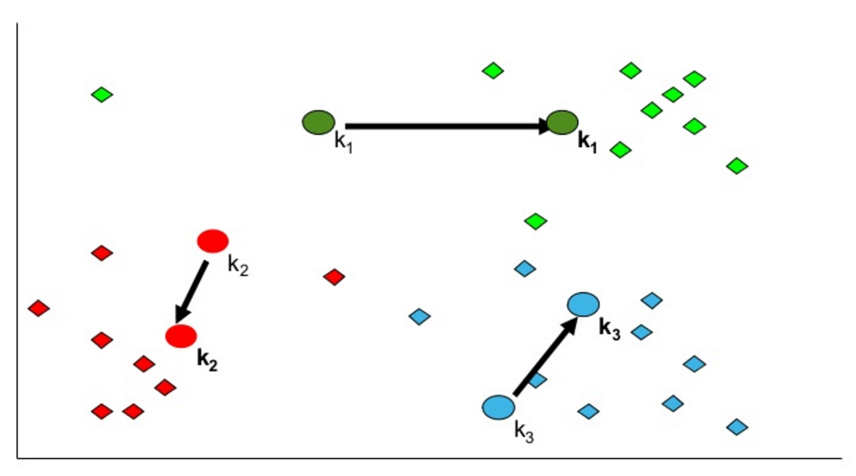
Recompute Cluster Centers
Move each cluster to the mean of each cluster.

Slide 25
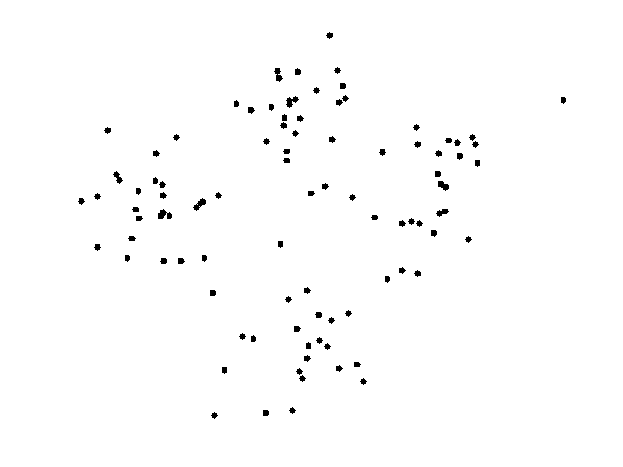
K-means Clustering

Slide 26
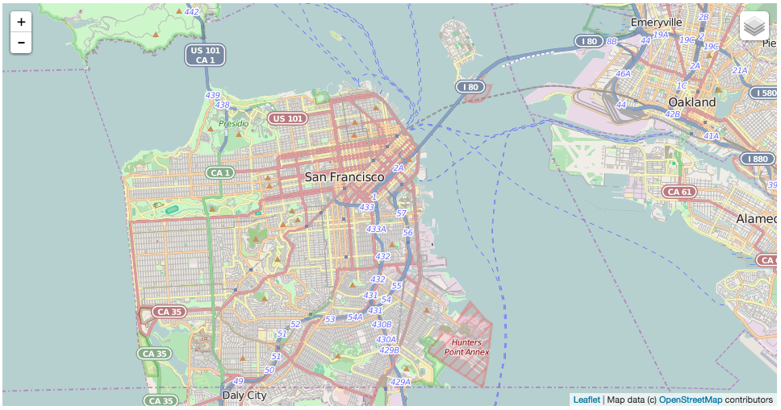
San Francisco

Slide 27
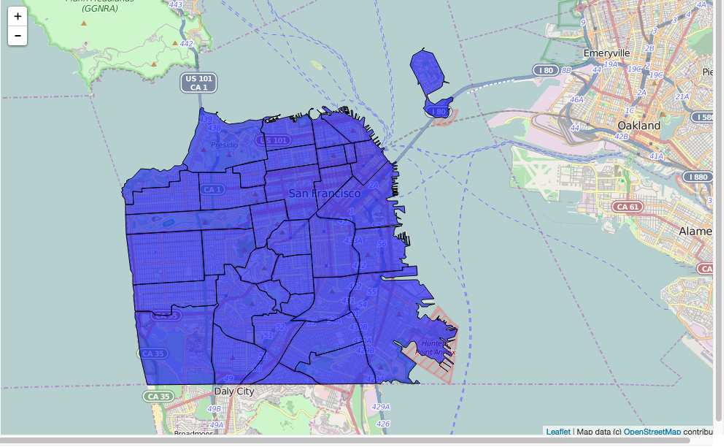
Outline Each Neighborhood

Slide 28
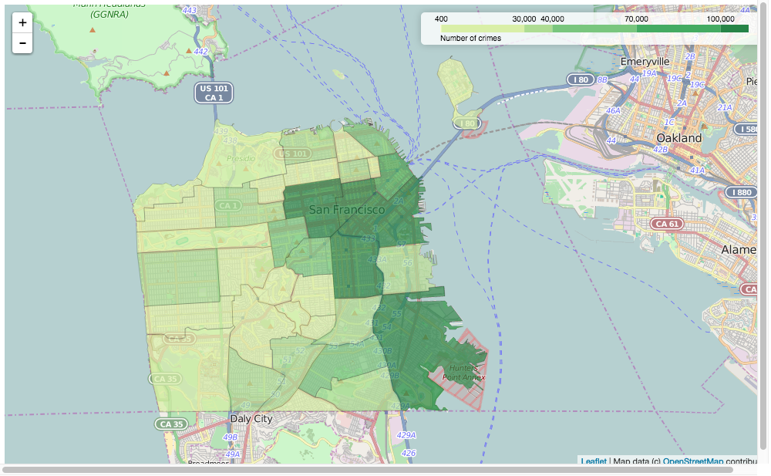
Folium: choropleth map

Slide 29
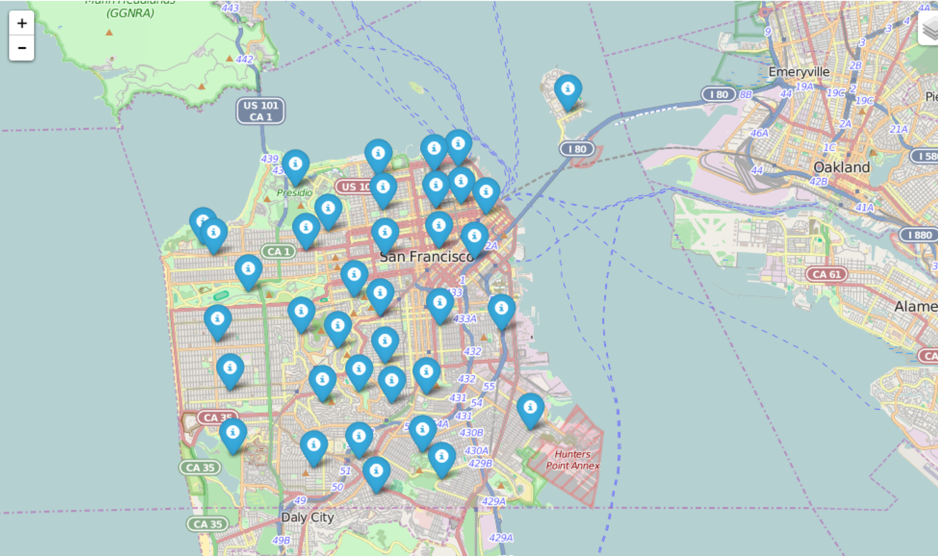
SF Neighborhood Centers Calculated with K-Means

Slide 30
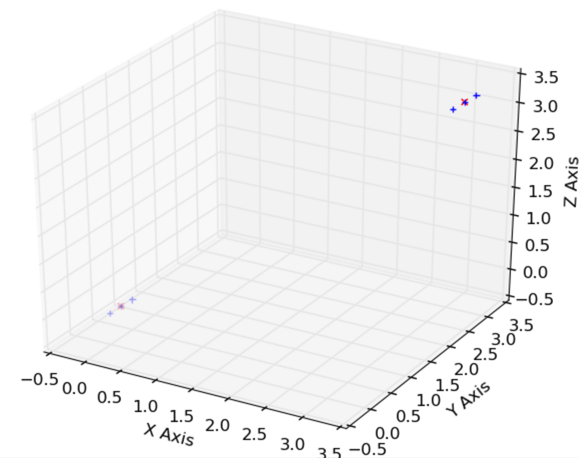
Sample Dataset – K-Means
0.0, 0.0, 0.0
0.1, 0.1, 0.1
0.2, 0.2, 0.2
3.0, 3.0, 3.0
3.1, 3.1, 3.1
3.2, 3.2, 3.2

Slide 31
Decision Trees & Random Forests (Supervised Learning)

Slide 32
Why Decision Trees?
Simple to understand and interpret. (And explain to executives.)
Requires little data preparation. (Other techniques often require data normalisation, dummy variables need to be created and blank values to be removed.)
Performs well with large datasets.

Slide 33
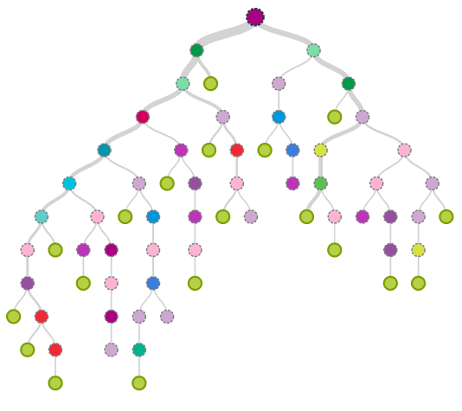
Visual Intro to Decision Trees
http://www.r2d3.us/visual-intro-to-machine-learning-part-1

Slide 34
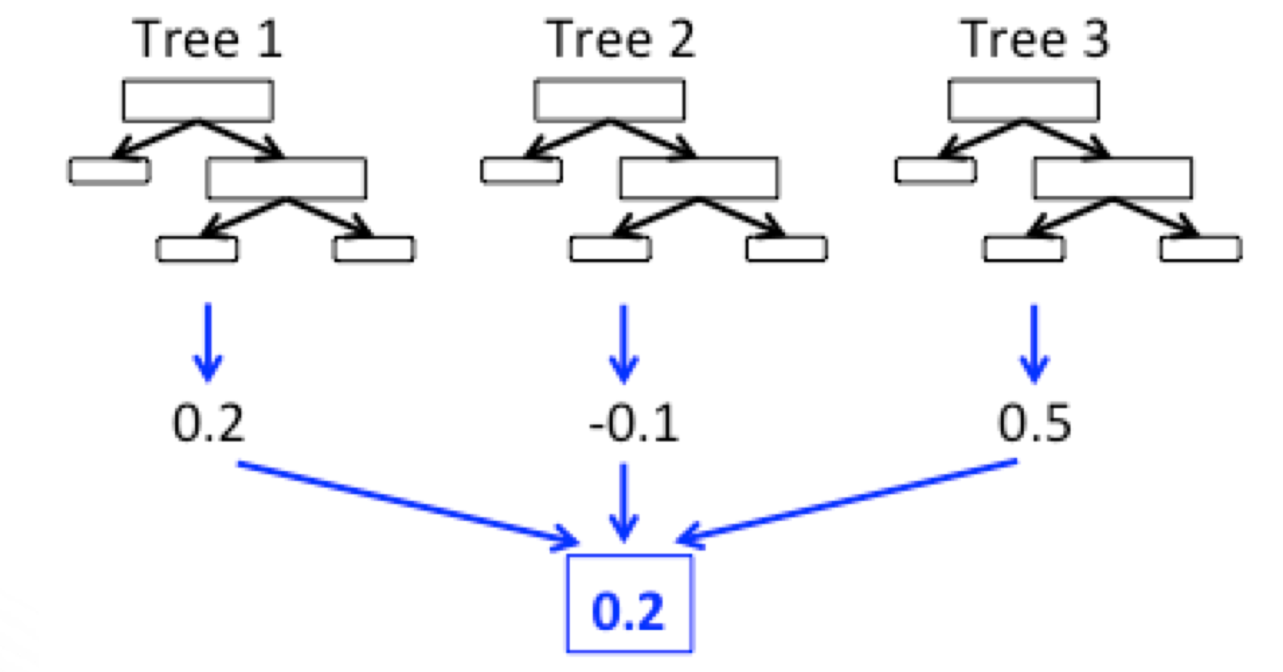
Random Forest (Ensemble Model)
Main idea: build an ensemble of simple decision trees
Each tree is simple and less likely to overfit
Classify/predict by voting between all trees

Slide 35
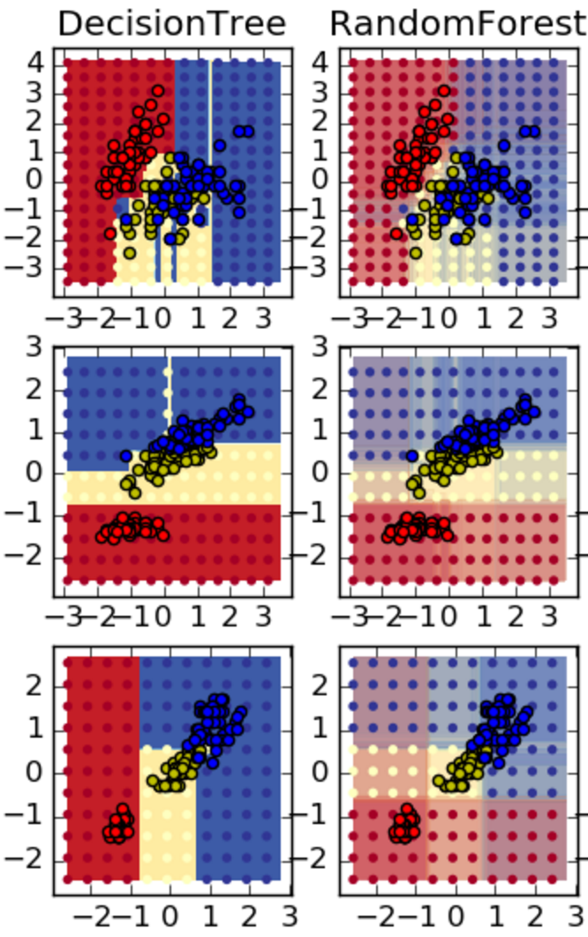
Decision Tree vs Random Forest

Slide 36
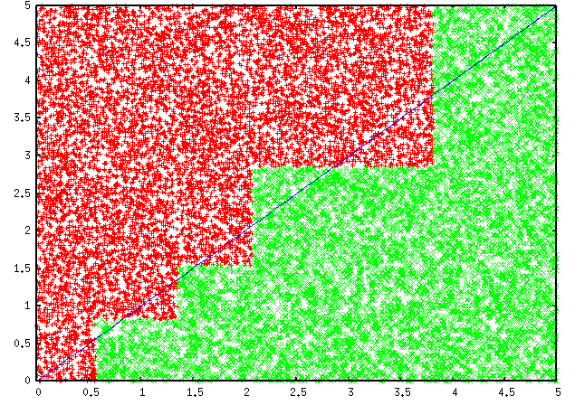
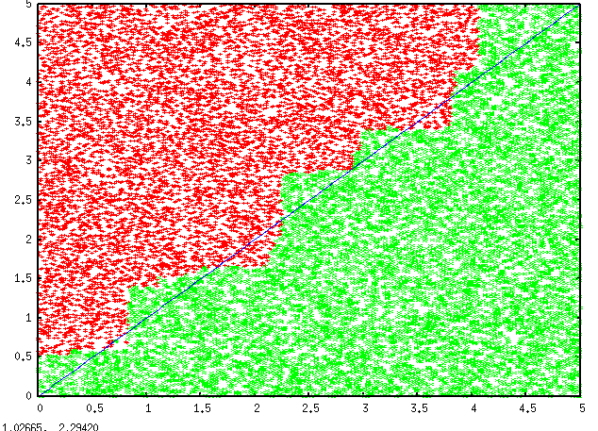
Why Ensembles work?
Overcome limitations of a single hypothesis
Decision Tree
Model Averaging

Slide 37
Diabetes Dataset – Decision Trees / Random Forest
Labeled set with 8 Features
-1 1:-0.294118 2:0.487437 3:0.180328 4:-0.292929 5:-1 6:0.00149028 7:-0.53117 8:-0.0333333 +1 1:-0.882353 2:-0.145729 3:0.0819672 4:-0.414141 5:-1 6:-0.207153 7:-0.766866 8:-0.666667 -1 1:-0.0588235 2:0.839196 3:0.0491803 4:-1 5:-1 6:-0.305514 7:-0.492741 8:-0.633333 +1 1:-0.882353 2:-0.105528 3:0.0819672 4:-0.535354 5:-0.777778 6:-0.162444 7:-0.923997 8:-1 -1 1:-1 2:0.376884 3:-0.344262 4:-0.292929 5:-0.602837 6:0.28465 7:0.887276 8:-0.6 +1 1:-0.411765 2:0.165829 3:0.213115 4:-1 5:-1 6:-0.23696 7:-0.894962 8:-0.7 -1 1:-0.647059 2:-0.21608 3:-0.180328 4:-0.353535 5:-0.791962 6:-0.0760059 7:-0.854825 8:-0.833333
...

Slide 38
Machine Learning in Spark

Slide 39
Spark Ecosystem
Spark SQL
Spark Streaming
MLlib
GraphX
Spark Core

Slide 40
Machine Learning with Spark (MLlib & ML)
MLlib
Original “lower” API
Built on top of RDDs
Maintenance mode starting with Spark 2.0
Both algorithms implemented to take advantage of data parallelism
ML
Newer “higher-level” API for constructing workflows
Built on top of DataFrames

Slide 41
Supervised Learning: End-to-End Flow
Training set
Feature Matrix
Training
(batch)
Data items
Feature Extraction
Train the Model
Model
Labels
Predicting
(real time or batch)
Feature Extraction
Feature Vector
Predict
Model
Data item
Label

Slide 42
Spark ML: Spark API for building ML pipelines
Feature transform 1
Feature transform 2
Combine features
Random Forest
Pipeline
Input DataFrame
(TRAIN)
Pipeline Model
Input DataFrame
(TEST)
Output Dataframe
(PREDICTIONS)

Slide 43
Spark ML Pipeline
Pipeline includes both fit() and transform() methods
fit() is for training
transform() is for prediction
Pipeline
Input DataFrame
(TRAIN)
Pipeline Model
fit()
Input DataFrame
(TEST)
transform()
Output Dataframe
(PREDICTIONS)
model = pipe.fit(trainData) # Train model
results = model.transform(testData) # Test model

Slide 44
Spark ML – Simple Random Forest Example
indexer = StringIndexer(inputCol=”district", outputCol=”dis-inx")
parser = Tokenizer(inputCol=”text-field", outputCol="words")
hashingTF = HashingTF(numFeatures=50, inputCol="words", outputCol="hash-inx")
vecAssembler = VectorAssembler(
inputCols =[“dis-inx”, “hash-inx”],
outputCol="features")
rf = RandomForestClassifier(numTrees=100, labelCol="label", seed=42)
pipe = Pipeline(stages=[indexer, parser, hashingTF, vecAssembler, rf])
model = pipe.fit(trainData) # Train model
results = model.transform(testData) # Test model

Slide 45
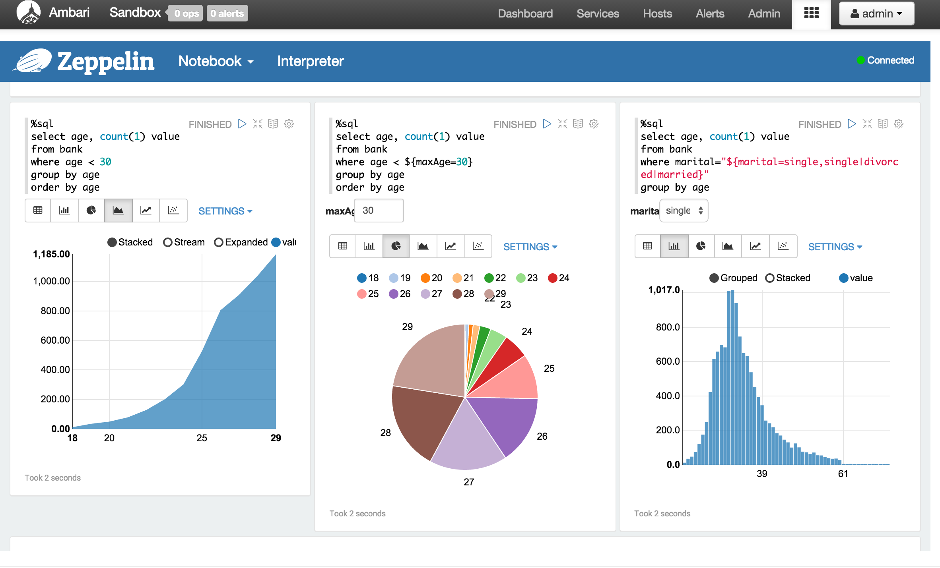
Apache Zeppelin – A Modern Web-based Data Science Studio
Data exploration and discovery
Visualization
Deeply integrated with Spark and Hadoop
Pluggable interpreters
Multiple languages in one notebook: R, Python, Scala

Slide 46
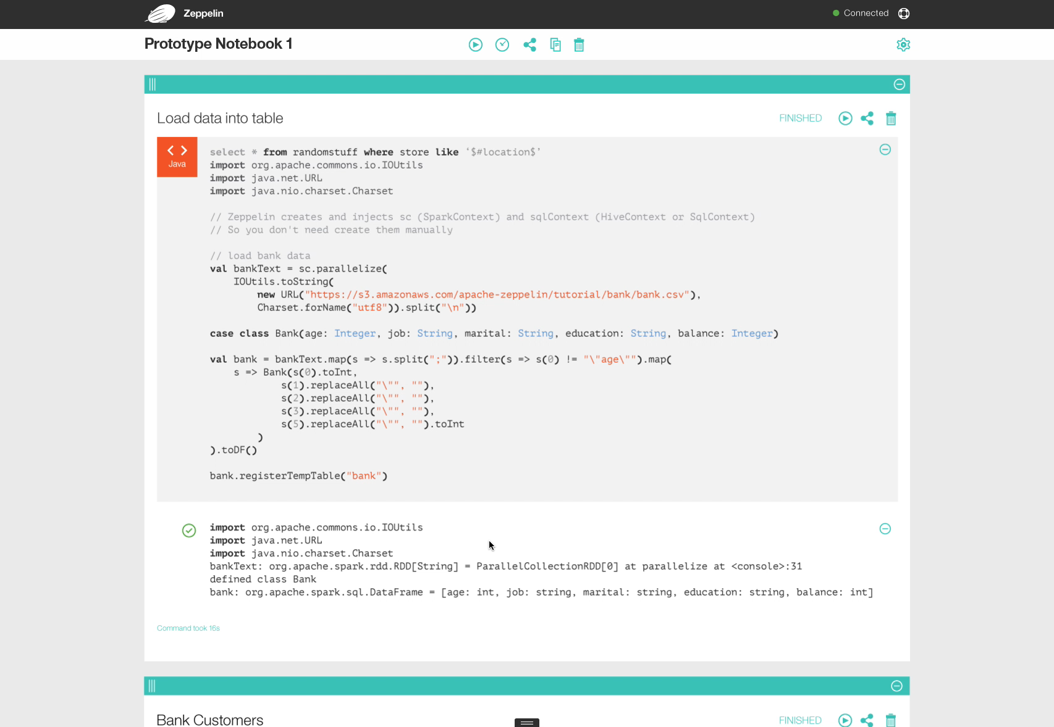

Slide 47
Exporting ML Models - PMML
Predictive Model Markup Language (PMML)
Supported models
K-Means
Linear Regression
Ridge Regression
Lasso
SVM
Binary

Slide 48



Additional Resources
Machine Learning
Natural Language Processing (NLP)
Scalable Machine Learning
Introduction to Statistics

Slide 49
Lab Overview
tinyurl.com/hwx-intro-to-ml-with-spark

Slide 50
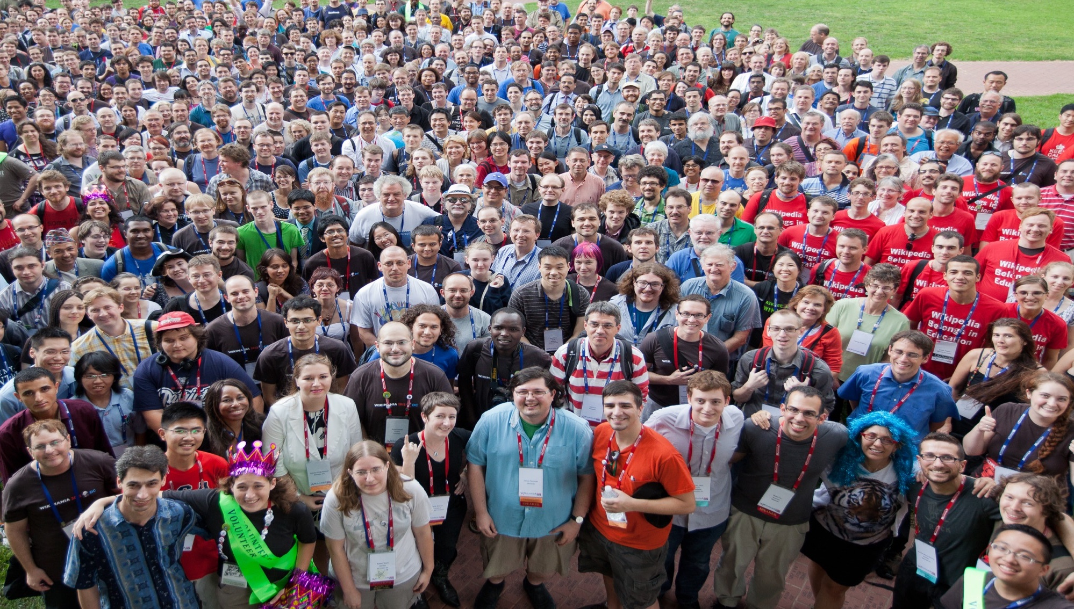

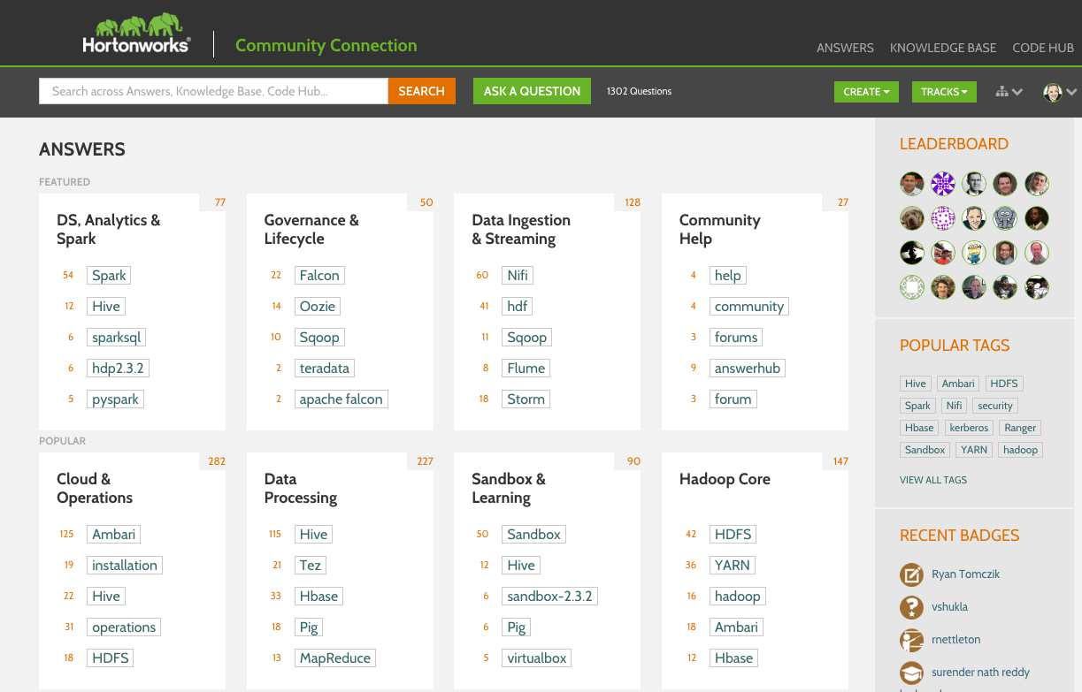
Hortonworks Community Connection
Full Q&A Platform (like StackOverflow)
Knowledge Base Articles
Code Samples and Repositories
Read access for everyone, join to participate and be recognized

Slide 51
Community Engagement
One Website!
7,500+
Registered Users
15,000+
Answers
20,000+
Technical Assets
community.hortonworks.com
© Hortonworks Inc. 2011 – 2015. All Rights Reserved

Slide 52
Thanks!
Robert Hryniewicz
@RobHryniewicz

